Slide 1
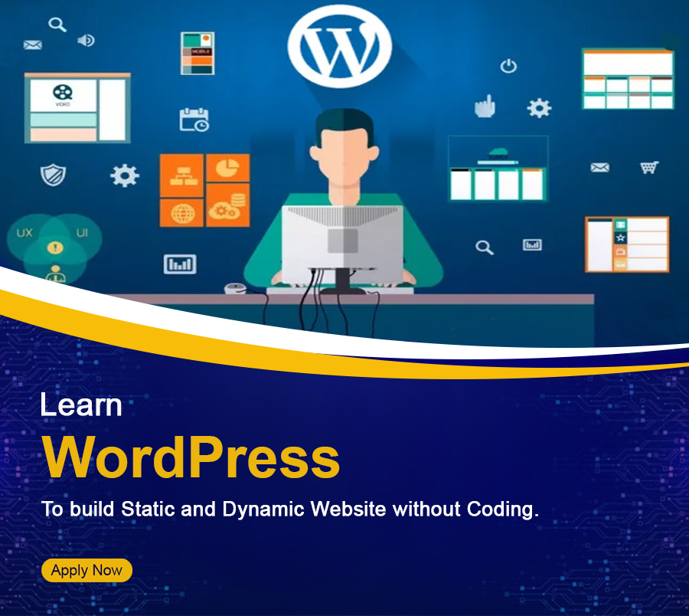
CERTIFICATION IN
WordPress Development
About Course :
WordPress is an open source CMS (Content Management System) that helps to build websites with some pre-built functions. WordPress is the most demanding CMS nowadays and the demand for WordPress developers is increasing rapidly. In this course, you will learn to create a new website from scratch using WordPress themes and plugins.

Slide 2
Learning Outcomes:
Ability to create your own Plugins and themes.
Create User-Friendly Pages for websites.
Learn to add pages, content, blogs, images, etc.
Learn to implement API on the website.
Build Responsive Websites
Learn to add new fields to WordPress
You will create applications in 62 Languages
You will create a WordPress website for businesses, organizations, institutions, etc.
Course Duration
1 months, 25 hr
Minimum Eligibility Criteria
Academic Qualification : 10th pass

Slide 3
Course Content :
S. No | Topics | No. of Hours
1 | Overview of WordPress | 2
2 | Installation | 2
3 | Settings | 2
4 | Categories | 2
5 | Posts | 1
6 | Media | 2
7 | Pages | 2
8 | Tags | 2
9 | Comments | 2
10 | Plugins | 2
11 | Users | 1
12 | Appearance | 2
13 | Advanced | 1
14 | Links | 2
 | Total | 25
Overview of WordPress
What is content management system (cms)?
Features
Advantages
Disadvantages

Slide 4
Installation
System requirements for wordpress
Download wordpress
Create store database
Set up wizard
Dashboard
Dashboard menu
Screen options
Welcome
Quick draft
Wordpress news
Activity
Settings
General settings
Writing settings
Reading settings
Discussion settings
Media settings
Permalink settings
Plugin settings
Categories
Add-category
Edit-category
Delete-category
Arrange-category
Posts
Add posts
Edit Posts
Delete posts

Slide 5
Preview posts
Publish posts
Media
Media Library
Add Media
Insert Media
Edit Media
Pages
Add Pages
Title
Text insertion
Publish
Page Attribute
Featured images
Publish Pages
Edit
Delete Pages
Tags
Add tags
Edit tags
Delete tags
Comments
Add comments
Edit comments
Moderate comments
Plugins
View plugins

Slide 6
Install plugins
Customize plugins
Users
User roles
Add users
User photo
Edit users
Delete users
Personal profile
Appearance
Theme Management
Customize Theme
Widget Management
background
Advanced
Version Update
Spam Protection
Backup & Restore
WordPress Files Backup
WordPress Database Backup
Restoring WordPress Files
Restoring WordPress Database
Optimization
Reset Password
Links
Add links
Edit links
Delete links

Slide 7
Why choose ifda institute
Expert Trainers
Flexible Batch
Online class
Doubt class
Job Oriented Training
Live Project Work
Verifiable certificate
100% Job assistance
Career Opportunity
WordPress Developer
Content Creator
WordPress Designer
WordPress Trainer
Freelancer
Enterpreneur
Registered Office – H-18/B, 2nd floor, Kalkaji Main Road, ND-19
Head office G-33, 1st floor, Kalkaji Main Road, New Delhi-19
Branch:- E-9, 2nd floor, Chandramal Complex, Near Police station, Badarpur, ND-44
Tele- 011-26482274, Mob:- 9999196162, 9999199651, E-mail- Info@ifda.in, web- ifda.in

